Slide 1
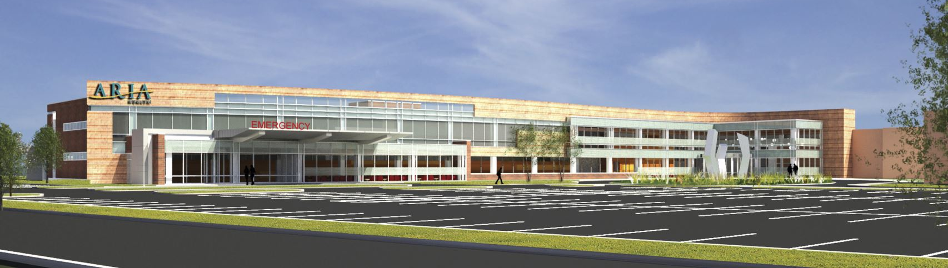
Aria Health | Torresdale Campus
Emergency Department | Expansion
Senior Thesis Presentation | April 16th, 2014
Robert M. Stano | AE | Construction Option
Adviser | Dr. Chimay Anumba

Slide 2
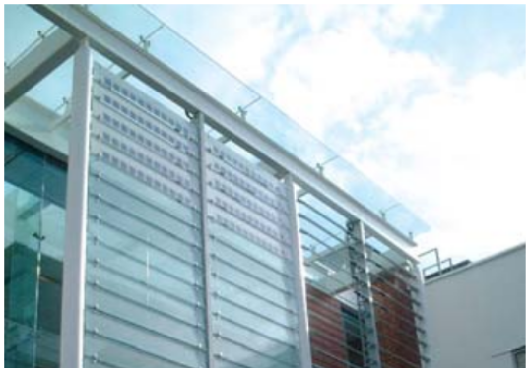
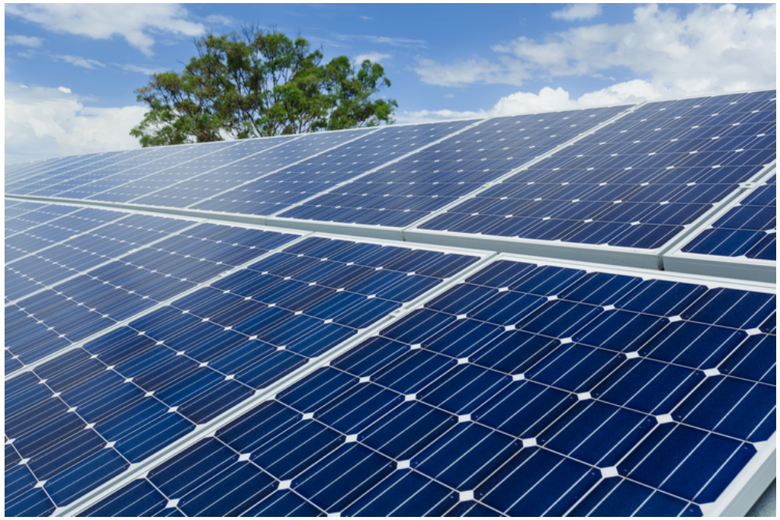
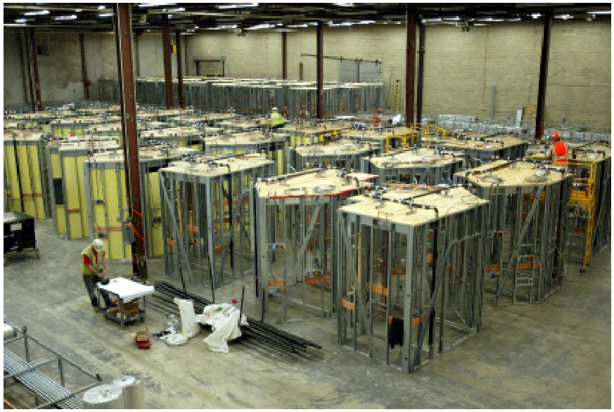
Project Summary
Analysis 1: Rainwater Collection
Analysis Goals
Data Collection
Description & Design
Cost Estimation
Economic Analysis
Analysis 2: Photovoltaic Array
Analysis Goals
Data Collection
Description & Design
Electrical Breadth
System Layout & Cost Estimation
Economic Analysis
Analysis 3: Operable Solar Shading
Analysis Goals
Colt Shadoglass
Cost Estimation
Sequencing, Schedule, Logistics
Energy Model
Mechanical Breadth
Thesis Recap
Acknowledgements
Bob Stano | Construction
Project Summary
Aria Health | Torresdale Campus | ED Expansion
Analysis 1 – Rainwater Collection
Analysis 3 – Operable Solar Shading
Overall Theme
Sustainable Construction
Analysis 4 – Modularization of Patient Treatment Rooms (not presented)
Analysis 2 – Photovoltaic Array

Slide 3
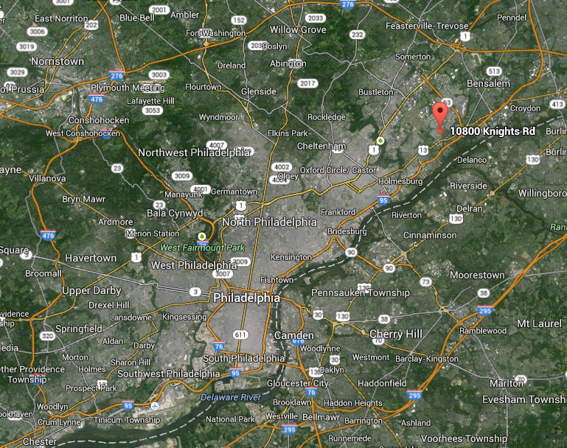
Project Summary
Analysis 1: Rainwater Collection
Analysis Goals
Data Collection
Description & Design
Cost Estimation
Economic Analysis
Analysis 2: Photovoltaic Array
Analysis Goals
Data Collection
Description & Design
Electrical Breadth
System Layout & Cost Estimation
Economic Analysis
Analysis 3: Operable Solar Shading
Analysis Goals
Colt Shadoglass
Cost Estimation
Sequencing, Schedule, Logistics
Energy Model
Mechanical Breadth
Thesis Recap
Acknowledgements
Bob Stano | Construction
Project Summary
Aria Health | Torresdale Campus | ED Expansion
Location: Philadelphia, PA
Building Information:
2 Stories Above Grade, 1 Below
Structural Steel
80,000 SF
Emergency Department Addition and Renovation
Construction:
$35 MM
2/25/13 – 6/27/14
CM at Risk
GMP Contract
Owner: Aria Health Systems
Owner’s Representative: Stantec
Architect: Francis Cauffman
MEP Design: PWI
Structural Design: O’Donnell & Naccarato
Civil Design: Barry Isett & Associates
Construction Manager: Turner Construction Company

Slide 4
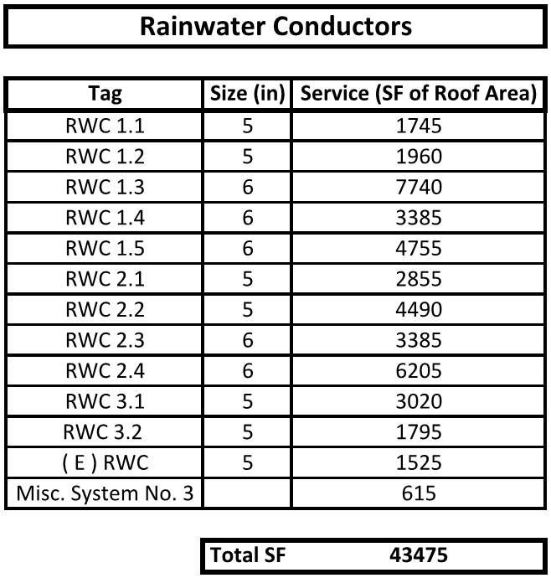
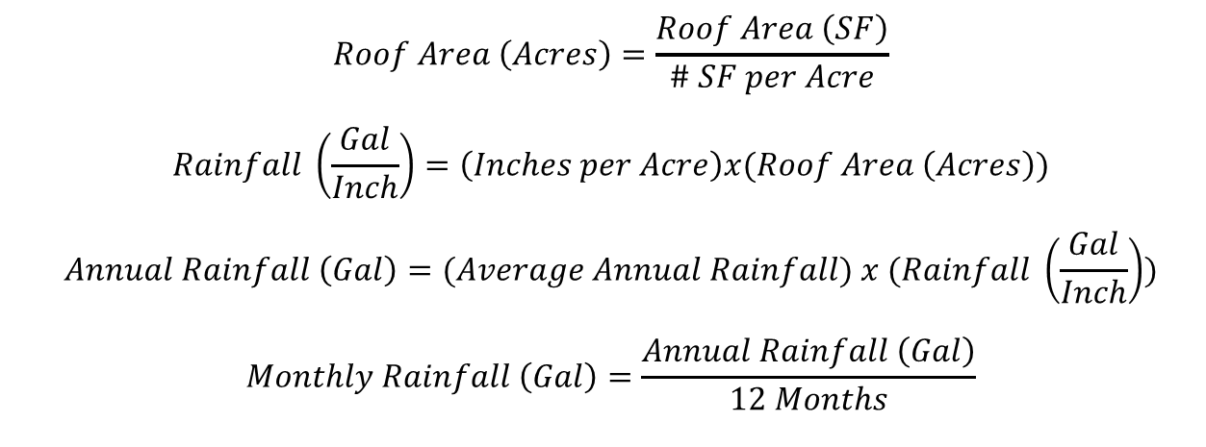
Project Summary
Analysis 1: Rainwater Collection
Analysis Goals
Data Collection
Description & Design
Cost Estimation
Economic Analysis
Analysis 2: Photovoltaic Array
Analysis Goals
Data Collection
Description & Design
Electrical Breadth
System Layout & Cost Estimation
Economic Analysis
Analysis 3: Operable Solar Shading
Analysis Goals
Colt Shadoglass
Cost Estimation
Sequencing, Schedule, Logistics
Energy Model
Mechanical Breadth
Thesis Recap
Acknowledgements
Bob Stano | Construction
Analysis 1 – Rainwater Collection
Aria Health | Torresdale Campus | ED Expansion
Analysis Goals
Data Collection
Data Collection
Primary: To show how sustainable construction techniques can be used for the purpose of resource conservation.

Slide 5
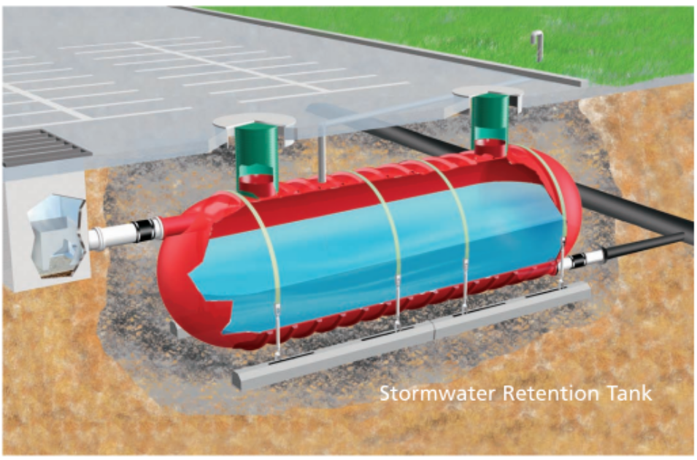
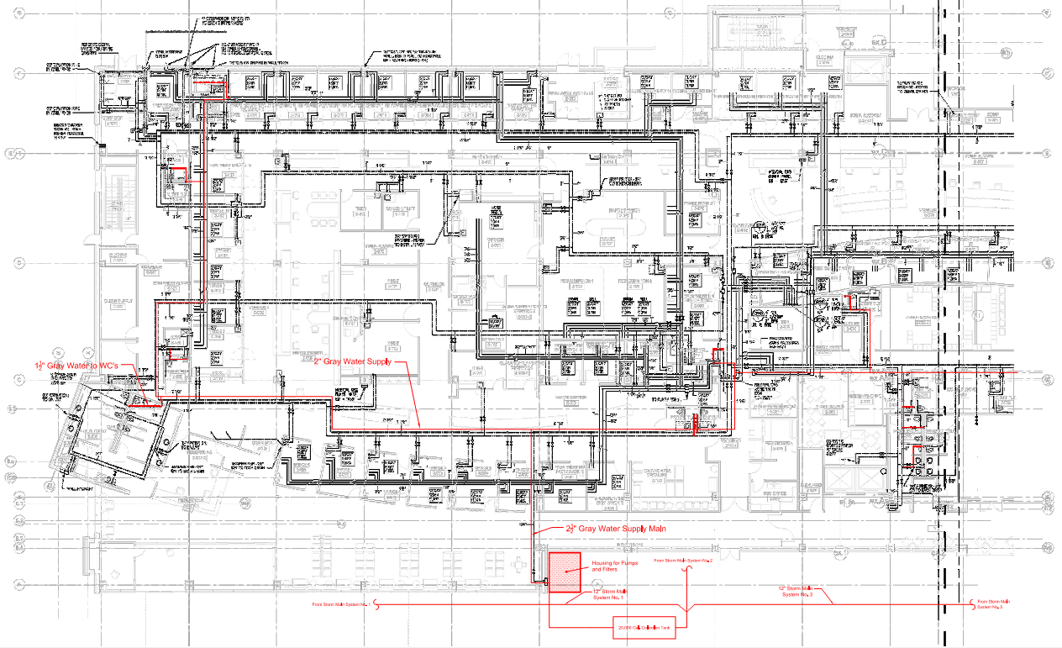
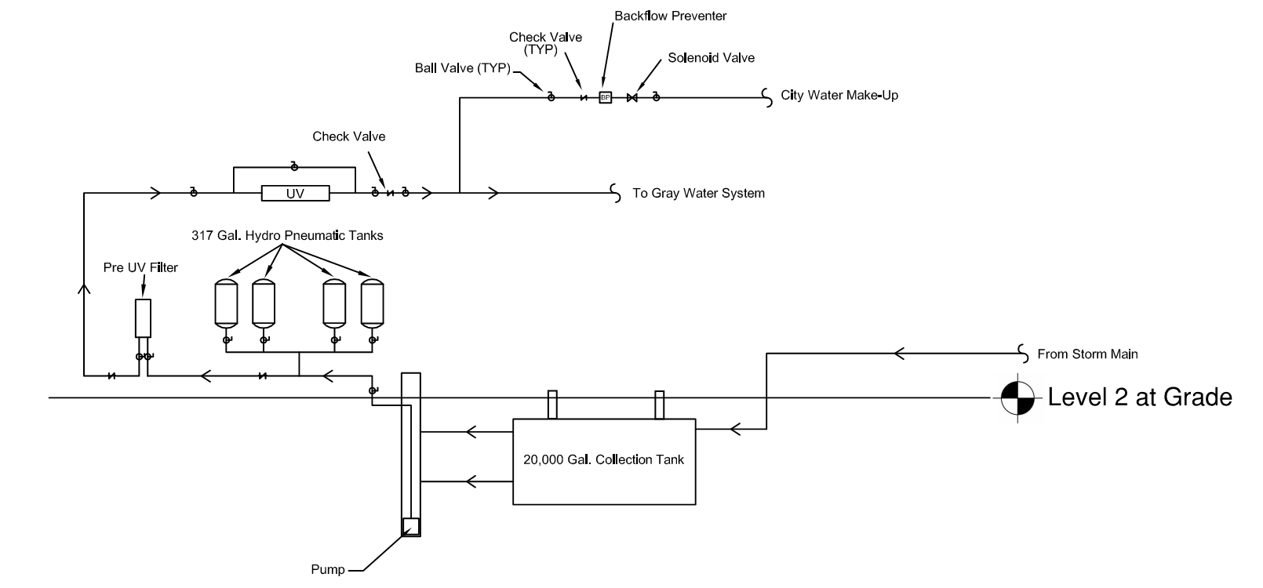
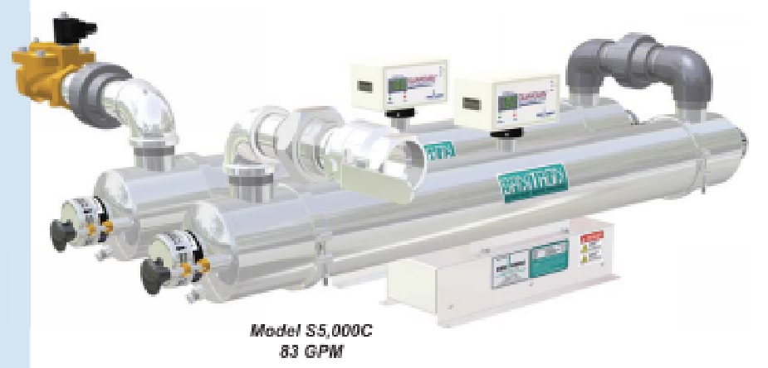
Project Summary
Analysis 1: Rainwater Collection
Analysis Goals
Data Collection
Description & Design
Cost Estimation
Economic Analysis
Analysis 2: Photovoltaic Array
Analysis Goals
Data Collection
Description & Design
Electrical Breadth
System Layout & Cost Estimation
Economic Analysis
Analysis 3: Operable Solar Shading
Analysis Goals
Colt Shadoglass
Cost Estimation
Sequencing, Schedule, Logistics
Energy Model
Mechanical Breadth
Thesis Recap
Acknowledgements
Bob Stano | Construction
Analysis 1 – Rainwater Collection
Aria Health | Torresdale Campus | ED Expansion
Description
Design
Design
85 GPM
Submersible

Slide 6
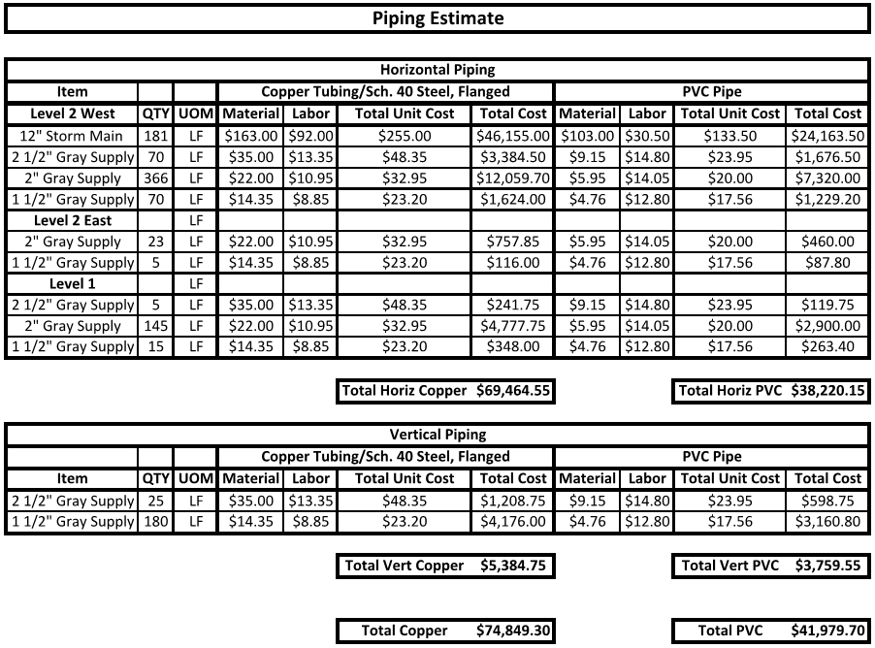
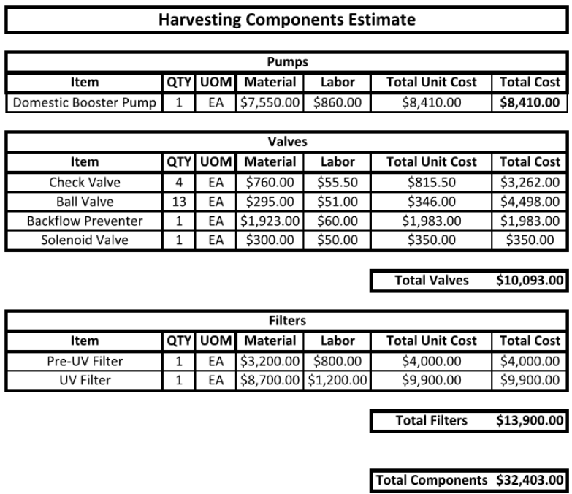
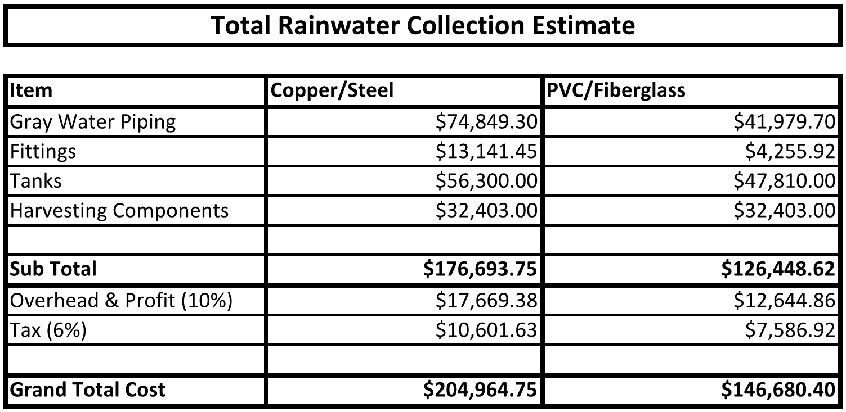
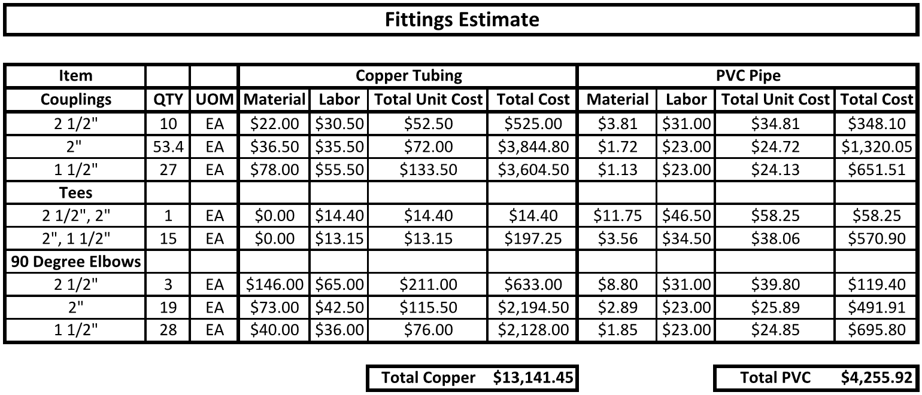
Project Summary
Analysis 1: Rainwater Collection
Analysis Goals
Data Collection
Description & Design
Cost Estimation
Economic Analysis
Analysis 2: Photovoltaic Array
Analysis Goals
Data Collection
Description & Design
Electrical Breadth
System Layout & Cost Estimation
Economic Analysis
Analysis 3: Operable Solar Shading
Analysis Goals
Colt Shadoglass
Cost Estimation
Sequencing, Schedule, Logistics
Energy Model
Mechanical Breadth
Thesis Recap
Acknowledgements
Bob Stano | Construction
Analysis 1 – Rainwater Collection
Aria Health | Torresdale Campus | ED Expansion
Cost Estimate

Slide 7
Project Summary
Analysis 1: Rainwater Collection
Analysis Goals
Data Collection
Description & Design
Cost Estimation
Economic Analysis
Analysis 2: Photovoltaic Array
Analysis Goals
Data Collection
Description & Design
Electrical Breadth
System Layout & Cost Estimation
Economic Analysis
Analysis 3: Operable Solar Shading
Analysis Goals
Colt Shadoglass
Cost Estimation
Sequencing, Schedule, Logistics
Energy Model
Mechanical Breadth
Thesis Recap
Acknowledgements
Bob Stano | Construction
Analysis 1 - Rainwater Collection
Aria Health | Torresdale Campus | ED Expansion

Slide 8
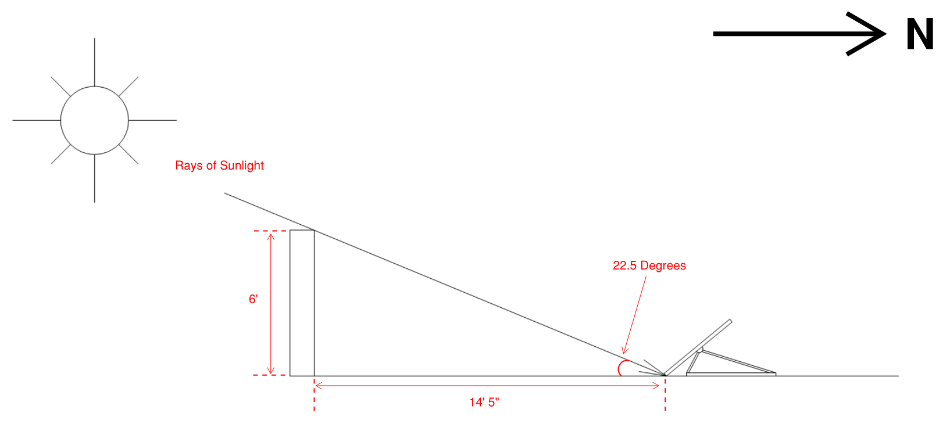
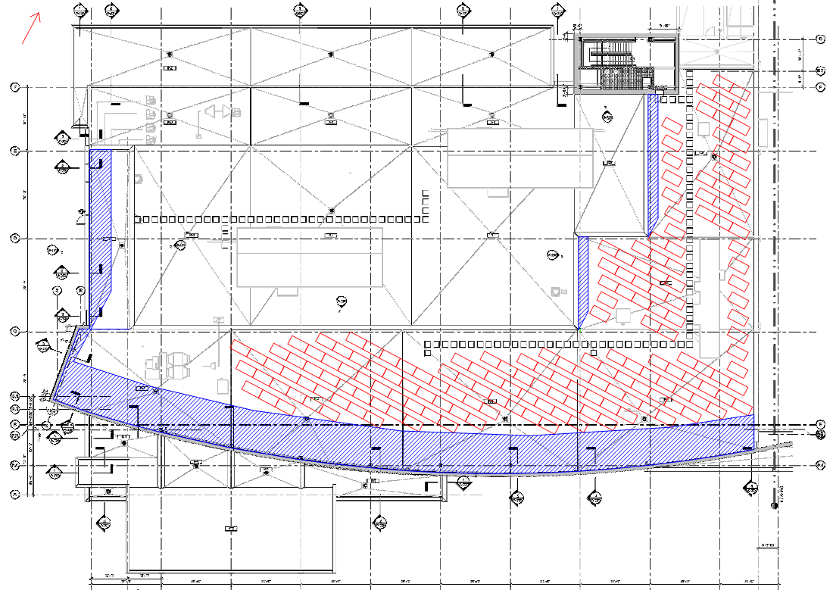
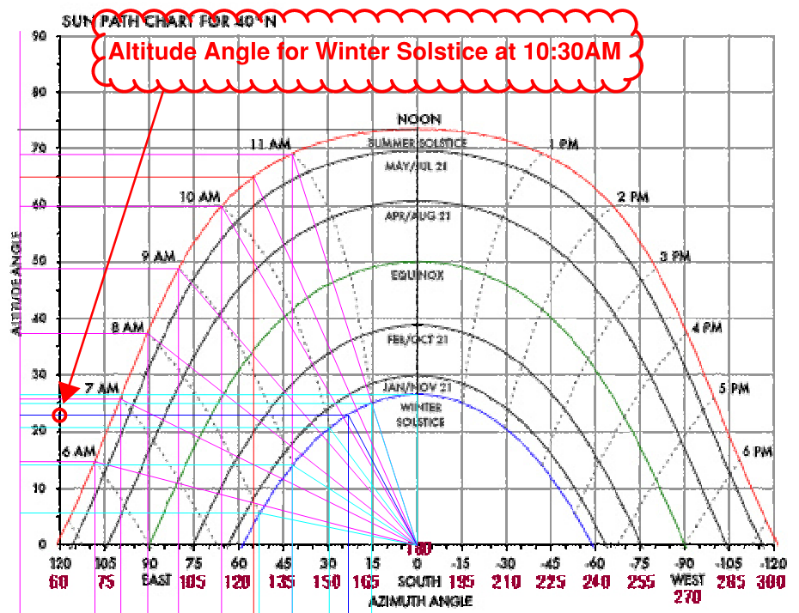
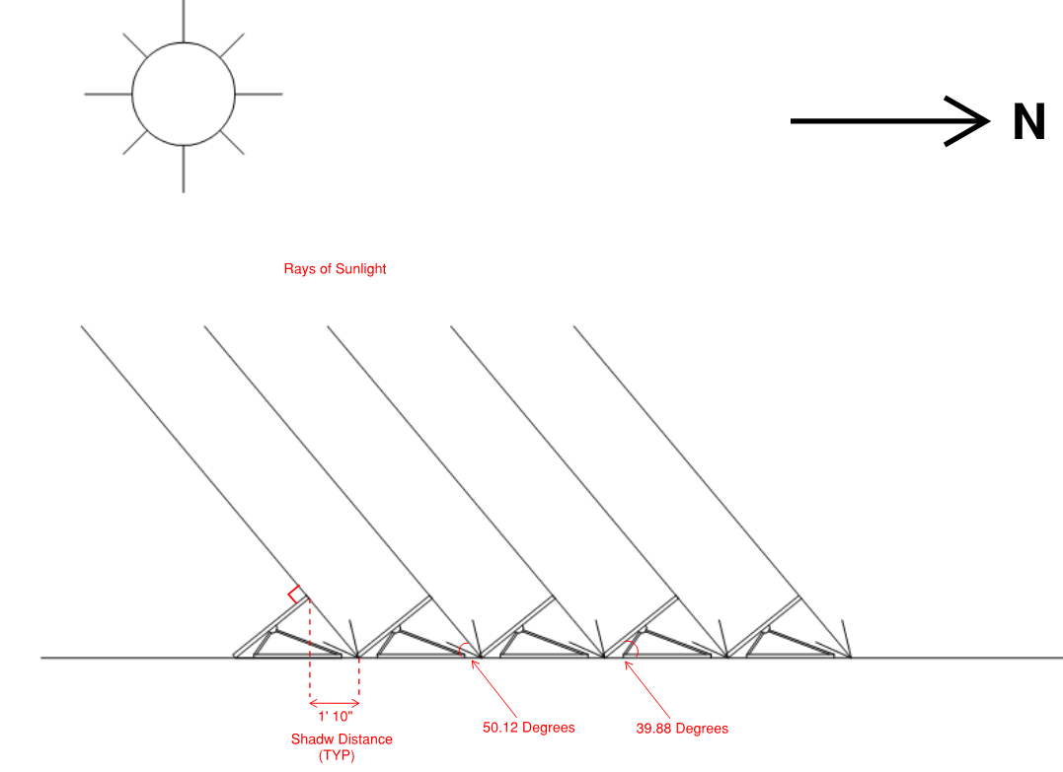
Project Summary
Analysis 1: Rainwater Collection
Analysis Goals
Data Collection
Description & Design
Cost Estimation
Economic Analysis
Analysis 2: Photovoltaic Array
Analysis Goals
Data Collection
Description & Design
Electrical Breadth
System Layout & Cost Estimation
Economic Analysis
Analysis 3: Operable Solar Shading
Analysis Goals
Colt Shadoglass
Cost Estimation
Sequencing, Schedule, Logistics
Energy Model
Mechanical Breadth
Thesis Recap
Acknowledgements
Bob Stano | Construction
Analysis 2 – Photovoltaic Array
Aria Health | Torresdale Campus | ED Expansion
Analysis Goals
Data Collection
Data Collection
Primary: To show how sustainable construction techniques can be used for the self-production of electricity.

Slide 9
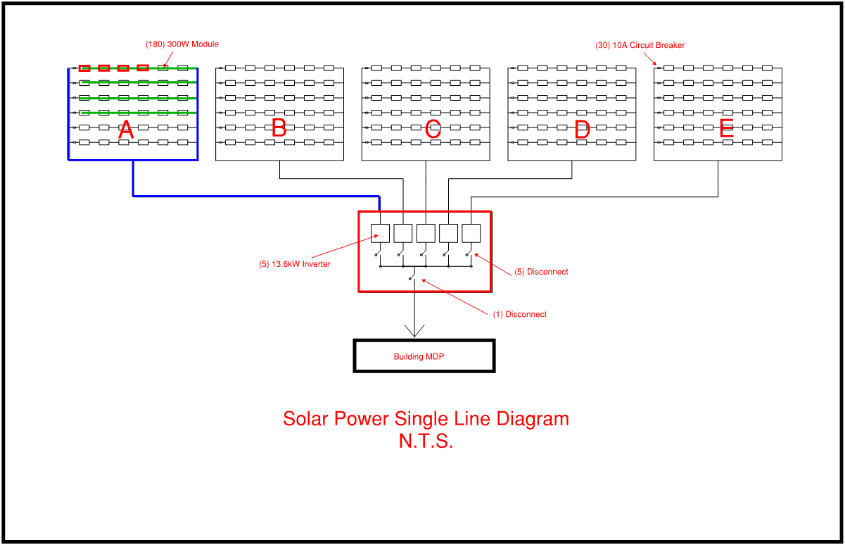
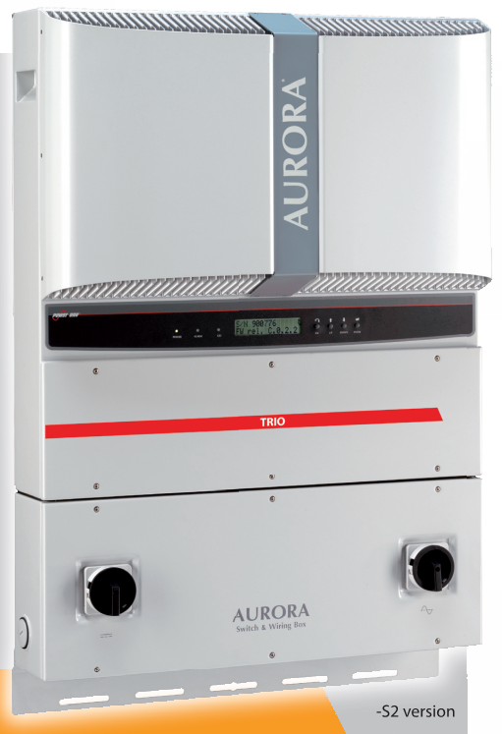
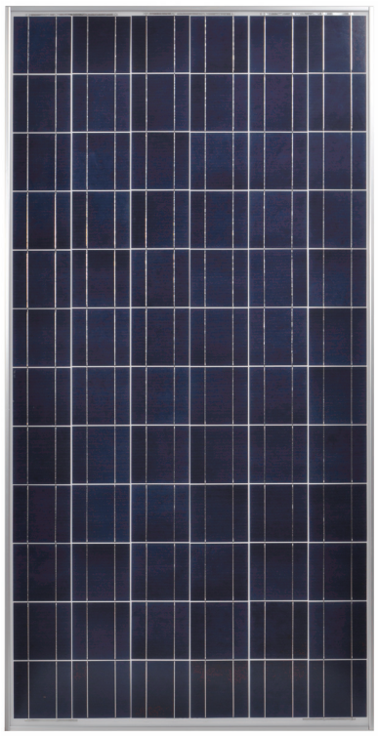
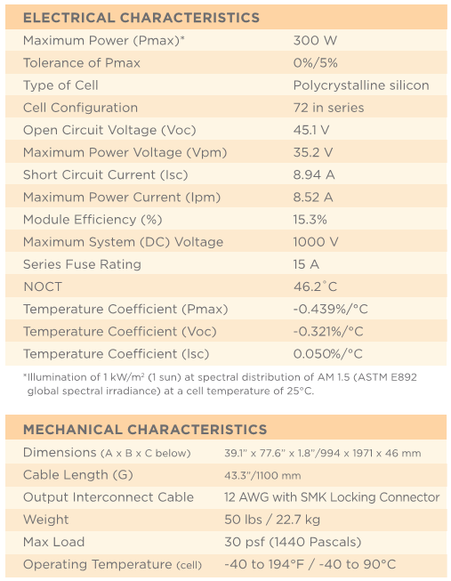
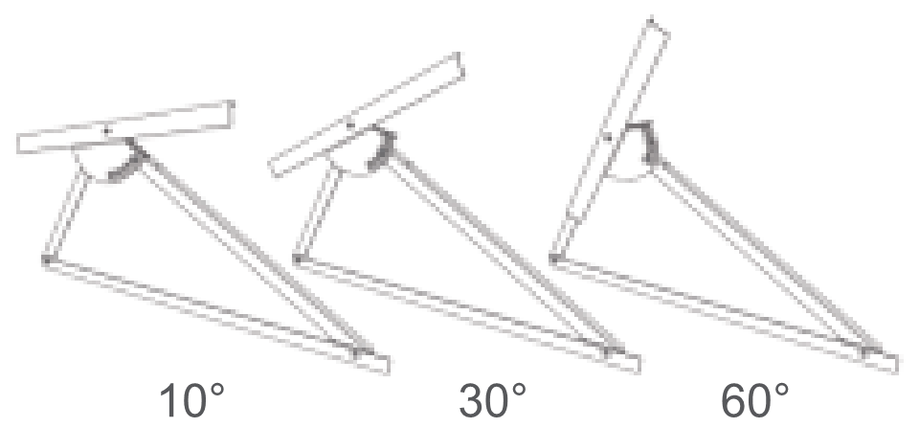
Project Summary
Analysis 1: Rainwater Collection
Analysis Goals
Data Collection
Description & Design
Cost Estimation
Economic Analysis
Analysis 2: Photovoltaic Array
Analysis Goals
Data Collection
Description & Design
Electrical Breadth
System Layout & Cost Estimation
Economic Analysis
Analysis 3: Operable Solar Shading
Analysis Goals
Colt Shadoglass
Cost Estimation
Sequencing, Schedule, Logistics
Energy Model
Mechanical Breadth
Thesis Recap
Acknowledgements
Bob Stano | Construction
Analysis 2 - Photovoltaic Array
Aria Health | Torresdale Campus | ED Expansion
Description & Design
10.8 kW Produced
Schletter VarioTop Racking System
Aurora PVI-12.0-I
Inverter
Sharp ND-F4Q300

Slide 10
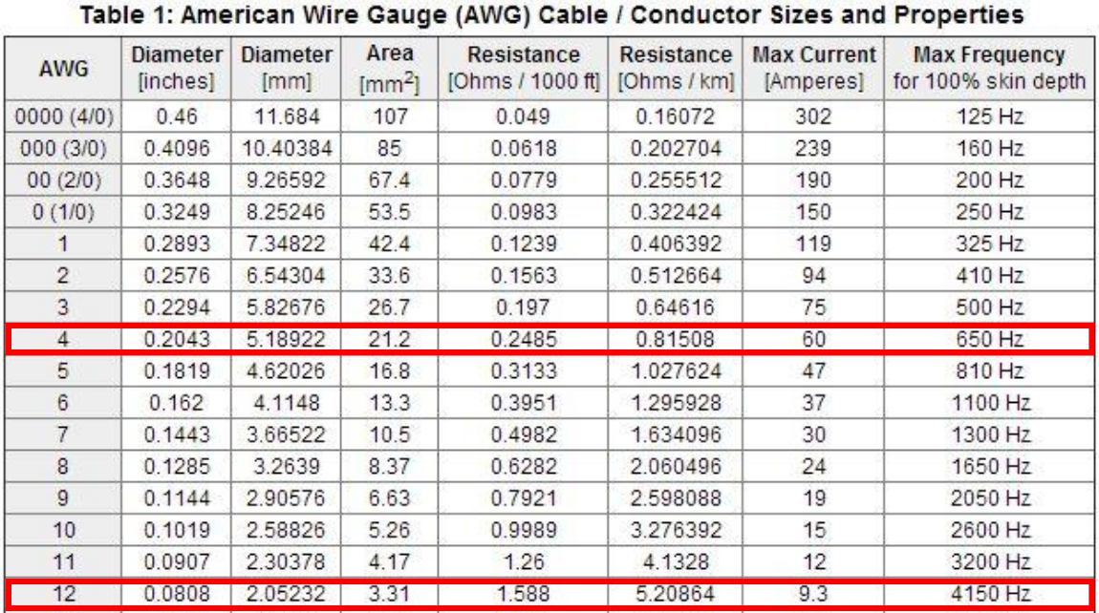
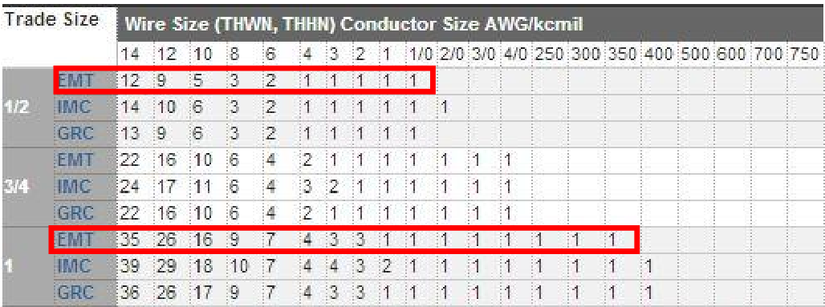
Project Summary
Analysis 1: Rainwater Collection
Analysis Goals
Data Collection
Description & Design
Cost Estimation
Economic Analysis
Analysis 2: Photovoltaic Array
Analysis Goals
Data Collection
Description & Design
Electrical Breadth
System Layout & Cost Estimation
Economic Analysis
Analysis 3: Operable Solar Shading
Analysis Goals
Colt Shadoglass
Cost Estimation
Sequencing, Schedule, Logistics
Energy Model
Mechanical Breadth
Thesis Recap
Acknowledgements
Bob Stano | Construction
Analysis 2 – Photovoltaic Array
Aria Health | Torresdale Campus | ED Expansion
Direct Current
$$W=VA$$
Alternating Current
Series Branch
$$Tot AC Pwr=44,300 Watts$$
$$V=\left(6 Modules\right)x(35.2V per Module)$$
$$A=\frac{W}{V\sqrt{3}}$$
$$V=211.2 Volts$$
$$A=\frac{\left(6 Modules\right)x\left(300W per Modules\right)}{211.2V}$$
$$A=\frac{44,300 W}{480\sqrt{3}}$$
$$A=8.52 Amps$$
Parallel Feeder
$$A=53.28 Amps$$
$$A=\left(8.52 Amps\right)x(6 Series Branches)$$
$$A=51.14 Amps$$

Slide 11
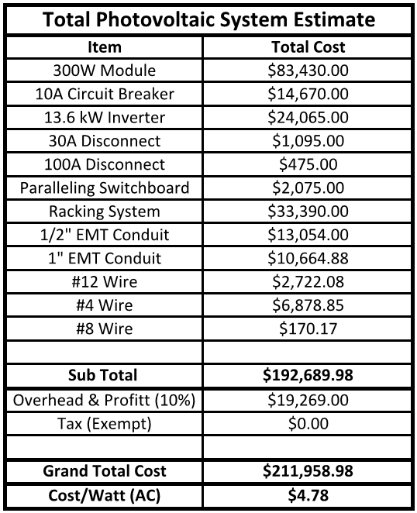
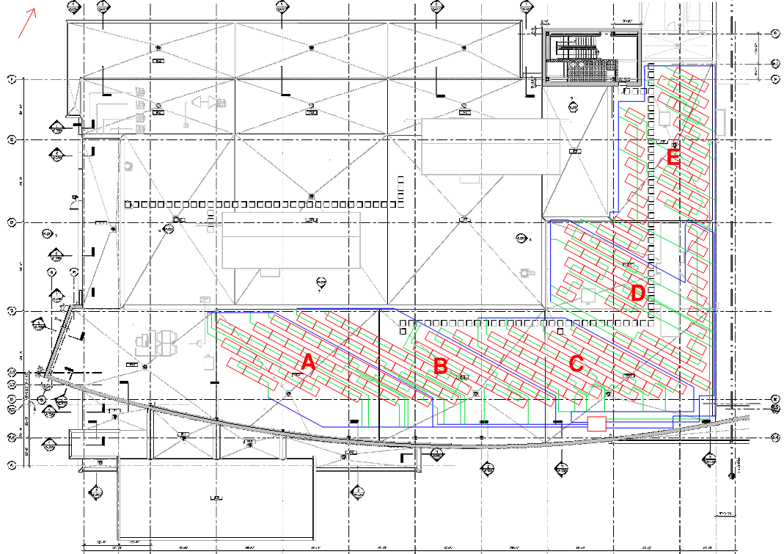
Project Summary
Analysis 1: Rainwater Collection
Analysis Goals
Data Collection
Description & Design
Cost Estimation
Economic Analysis
Analysis 2: Photovoltaic Array
Analysis Goals
Data Collection
Description & Design
Electrical Breadth
System Layout & Cost Estimation
Economic Analysis
Analysis 3: Operable Solar Shading
Analysis Goals
Colt Shadoglass
Cost Estimation
Sequencing, Schedule, Logistics
Energy Model
Mechanical Breadth
Thesis Recap
Acknowledgements
Bob Stano | Construction
Analysis 2 – Photovoltaic Array
Aria Health | Torresdale Campus | ED Expansion

Slide 12
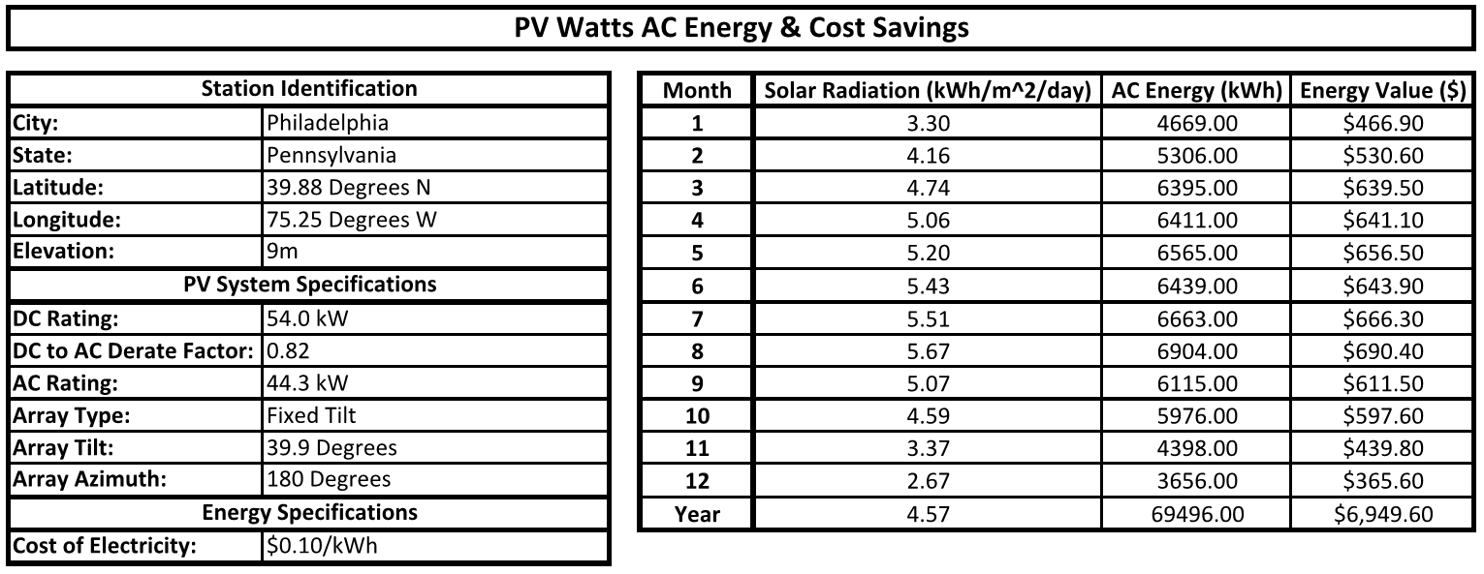
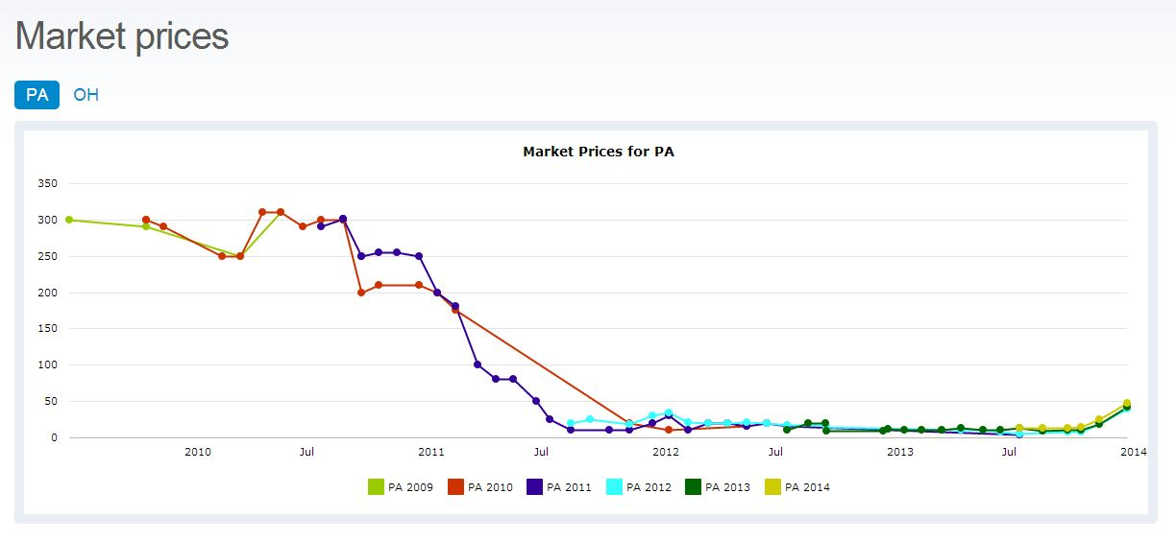
Project Summary
Analysis 1: Rainwater Collection
Analysis Goals
Data Collection
Description & Design
Cost Estimation
Economic Analysis
Analysis 2: Photovoltaic Array
Analysis Goals
Data Collection
Description & Design
Electrical Breadth
System Layout & Cost Estimation
Economic Analysis
Analysis 3: Operable Solar Shading
Analysis Goals
Colt Shadoglass
Cost Estimation
Sequencing, Schedule, Logistics
Energy Model
Mechanical Breadth
Thesis Recap
Acknowledgements
Bob Stano | Construction
Analysis 2 – Photovoltaic Array
Aria Health | Torresdale Campus | ED Expansion

Slide 13
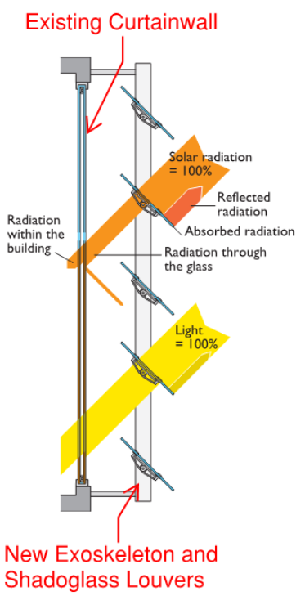
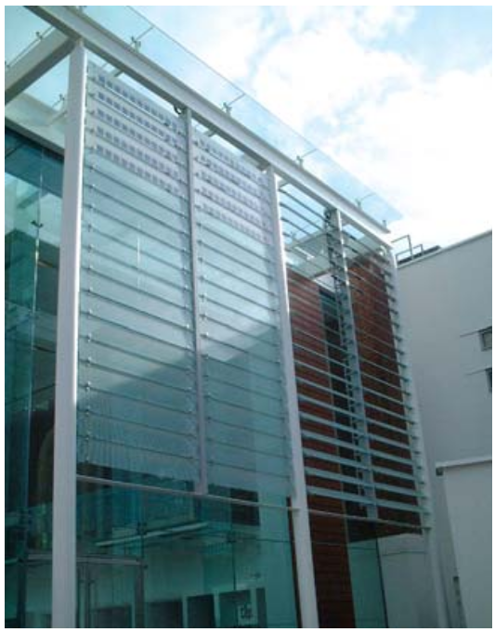
Project Summary
Analysis 1: Rainwater Collection
Analysis Goals
Data Collection
Description & Design
Cost Estimation
Economic Analysis
Analysis 2: Photovoltaic Array
Analysis Goals
Data Collection
Description & Design
Electrical Breadth
System Layout & Cost Estimation
Economic Analysis
Analysis 3: Operable Solar Shading
Analysis Goals
Colt Shadoglass
Cost Estimation
Sequencing, Schedule, Logistics
Energy Model
Mechanical Breadth
Thesis Recap
Acknowledgements
Bob Stano | Construction
Analysis 3 – Operable Solar Shading
Aria Health | Torresdale Campus | ED Expansion
Analysis Goals
Description
Description
Primary:
To show how sustainable construction techniques can be used for the purpose of annual energy savings.
Design and Prefabrication
Mestek’s Linel Fabrication
Automation
Preprogrammed Weather Data
Contractual Agreements
Lump Sum Quote
Procurement and Logistics
16-20 Week Lead

Slide 14
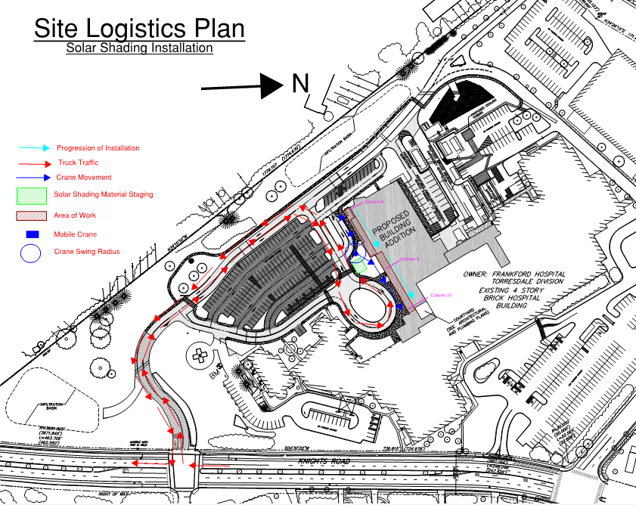
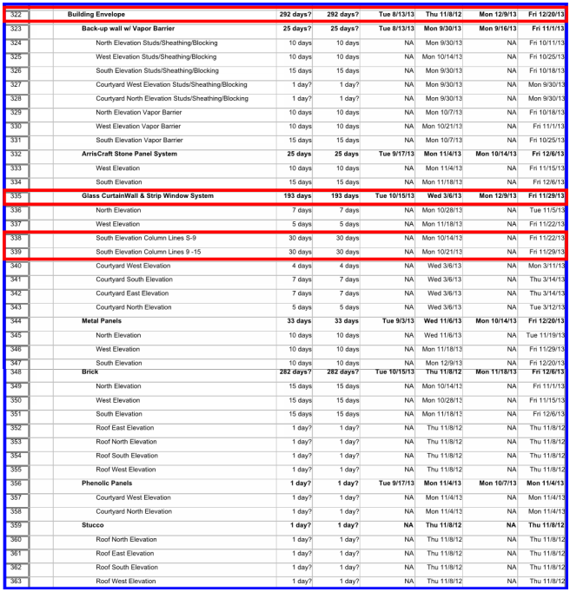
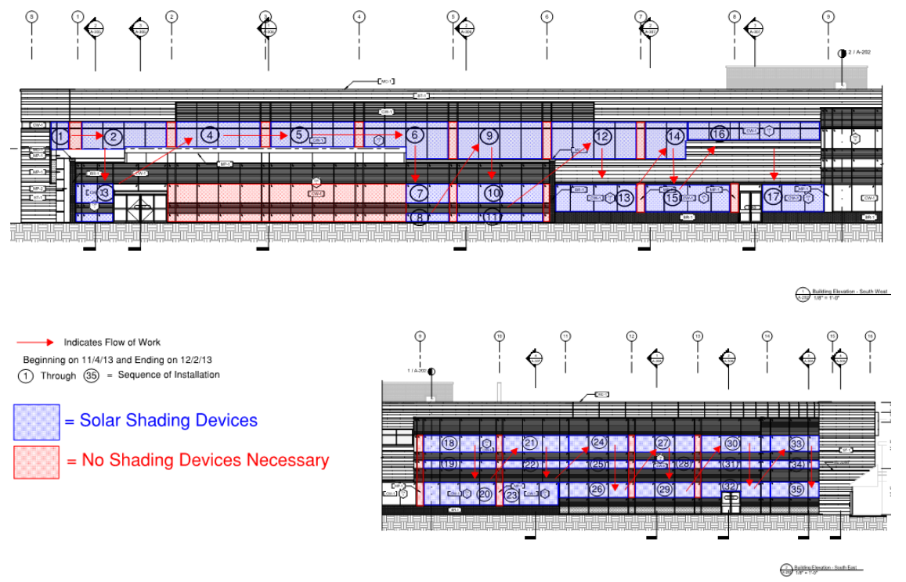
Project Summary
Analysis 1: Rainwater Collection
Analysis Goals
Data Collection
Description & Design
Cost Estimation
Economic Analysis
Analysis 2: Photovoltaic Array
Analysis Goals
Data Collection
Description & Design
Electrical Breadth
System Layout & Cost Estimation
Economic Analysis
Analysis 3: Operable Solar Shading
Analysis Goals
Colt Shadoglass
Cost Estimation
Sequencing, Schedule, Logistics
Energy Model
Mechanical Breadth
Thesis Recap
Acknowledgements
Bob Stano | Construction
Analysis 3 – Operable Solar Shading
Aria Health | Torresdale Campus | ED Expansion

Slide 15
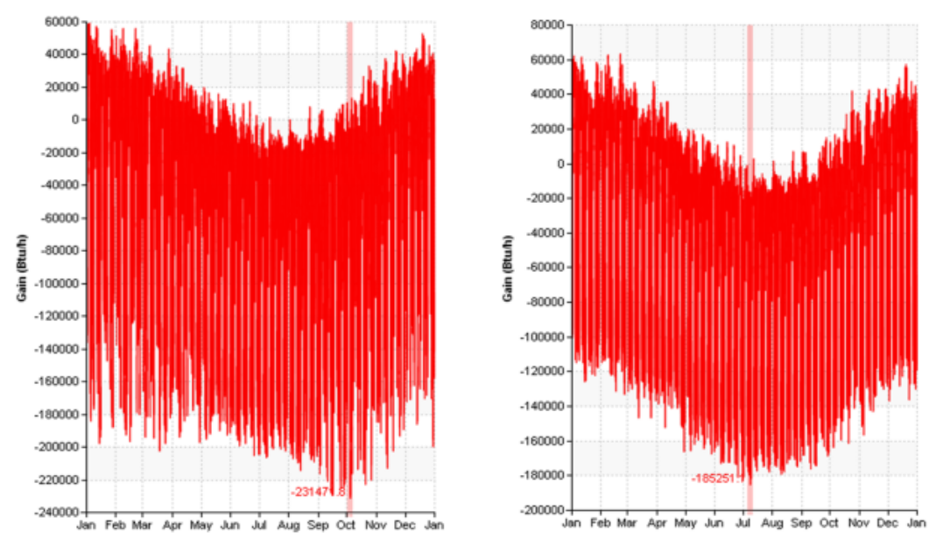
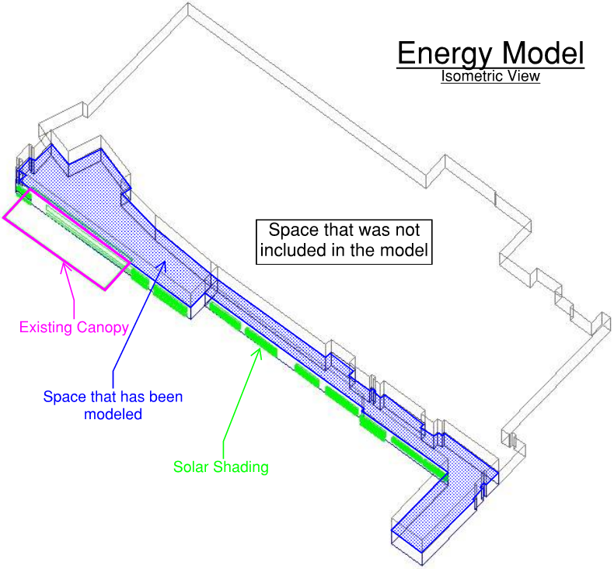
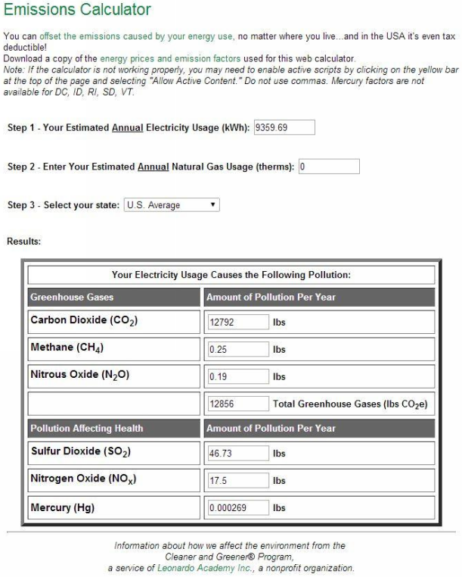
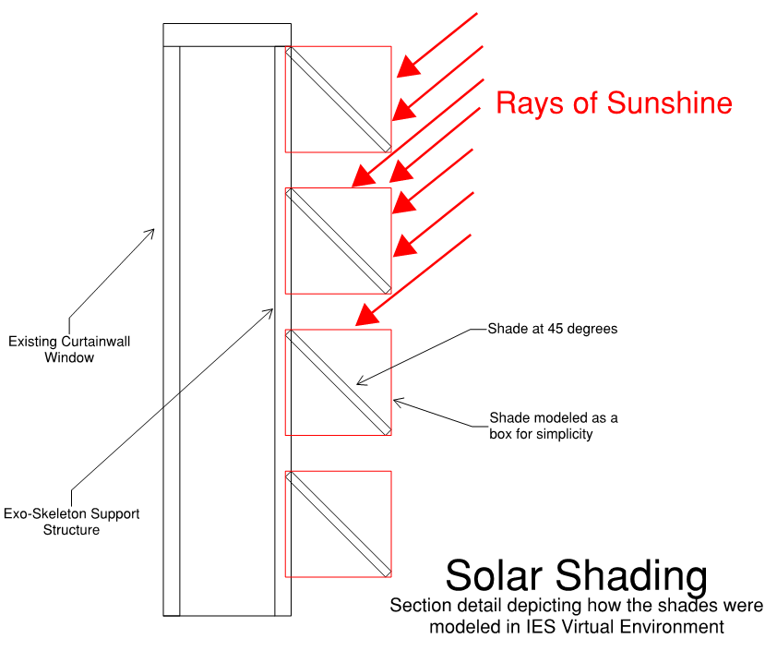
Project Summary
Analysis 1: Rainwater Collection
Analysis Goals
Data Collection
Description & Design
Cost Estimation
Economic Analysis
Analysis 2: Photovoltaic Array
Analysis Goals
Data Collection
Description & Design
Electrical Breadth
System Layout & Cost Estimation
Economic Analysis
Analysis 3: Operable Solar Shading
Analysis Goals
Colt Shadoglass
Cost Estimation
Sequencing, Schedule, Logistics
Energy Model
Mechanical Breadth
Thesis Recap
Acknowledgements
Bob Stano | Construction
Analysis 3 – Operable Solar Shading
Aria Health | Torresdale Campus | ED Expansion

Slide 16
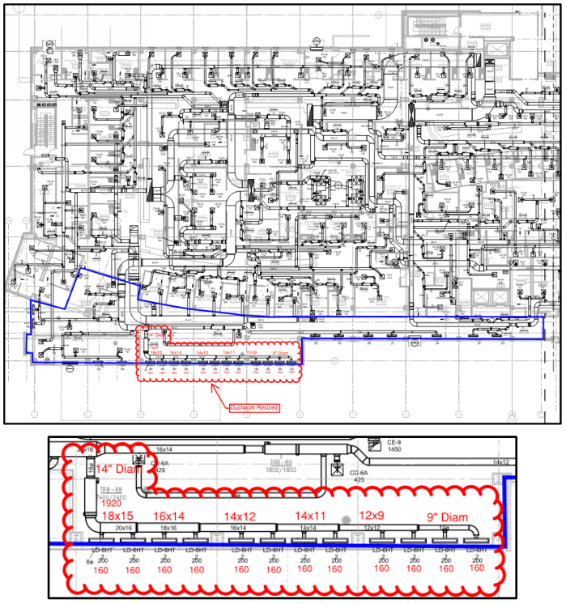
Project Summary
Analysis 1: Rainwater Collection
Analysis Goals
Data Collection
Description & Design
Cost Estimation
Economic Analysis
Analysis 2: Photovoltaic Array
Analysis Goals
Data Collection
Description & Design
Electrical Breadth
System Layout & Cost Estimation
Economic Analysis
Analysis 3: Operable Solar Shading
Analysis Goals
Colt Shadoglass
Cost Estimation
Sequencing, Schedule, Logistics
Energy Model
Mechanical Breadth
Thesis Recap
Acknowledgements
Bob Stano | Construction
Analysis 3 – Operable Solar Shading
Aria Health | Torresdale Campus | ED Expansion

Slide 17
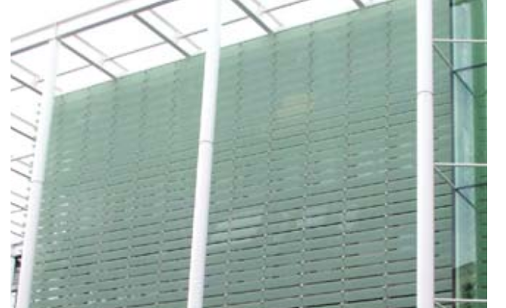
Project Summary
Analysis 1: Rainwater Collection
Analysis Goals
Data Collection
Description & Design
Cost Estimation
Economic Analysis
Analysis 2: Photovoltaic Array
Analysis Goals
Data Collection
Description & Design
Electrical Breadth
System Layout & Cost Estimation
Economic Analysis
Analysis 3: Operable Solar Shading
Analysis Goals
Colt Shadoglass
Cost Estimation
Sequencing, Schedule, Logistics
Energy Model
Mechanical Breadth
Thesis Recap
Acknowledgements
Bob Stano | Construction
Thesis Recap and Recommendations
Aria Health | Torresdale Campus | ED Expansion
Analysis 1 – Rainwater Collection
Analysis 3 – Operable Solar Shading
Analysis 2 – Photovoltaic Array
Initial Cost: $146,680.40
Payback: 12.18 Years
Cumulative Income: $281,105.50
Recommended
Initial Cost: $211,958.98
Payback: 19.52 Years
Cumulative Income: $94.467.20
NOT Recommended
Initial Cost: $442,533.33
Energy Savings: 20% Reduction in cooling load
Cost Savings: $935.97 savings per year
NOT Recommended

Slide 18
Project Summary
Analysis 1: Rainwater Collection
Analysis Goals
Data Collection
Description & Design
Cost Estimation
Economic Analysis
Analysis 2: Photovoltaic Array
Analysis Goals
Data Collection
Description & Design
Electrical Breadth
System Layout & Cost Estimation
Economic Analysis
Analysis 3: Operable Solar Shading
Analysis Goals
Colt Shadoglass
Cost Estimation
Sequencing, Schedule, Logistics
Energy Model
Mechanical Breadth
Thesis Recap
Acknowledgements
Bob Stano | Construction
Acknowledgements
Aria Health | Torresdale Campus | ED Expansion
Adviser:
Dr. Chimay Anumba, FREng., Ph.D., D.Sc., Dr.h.c., P.E.
Very Special Thanks:
Robert F. Stano, P.E.
Steven P. Mulhollen, P.E.
John C. Stewart, P.E.
Scott A. Mack, P.E.
Gregory D. Rummel, CPD
Cordell A. Adamy
Andrew Rhodes, P.E., DBIA, LEED BD+C
Francis O’Neill
Ted Border
Nicholas M. Rekstad
Kevin A. Martyn
Friends and Family
The Pennsylvania State University
Architectural Engineering
Faculty and Staff
Project Team:
Patrick F. Kershner, Project Manager
Michael Zarzycki, Superintendent
Tolulope A. Adenubi, Project Engineer

Slide 19
Project Summary
Analysis 1: Rainwater Collection
Analysis Goals
Data Collection
Description & Design
Cost Estimation
Economic Analysis
Analysis 2: Photovoltaic Array
Analysis Goals
Data Collection
Description & Design
Electrical Breadth
System Layout & Cost Estimation
Economic Analysis
Analysis 3: Operable Solar Shading
Analysis Goals
Colt Shadoglass
Cost Estimation
Sequencing, Schedule, Logistics
Energy Model
Mechanical Breadth
Thesis Recap
Acknowledgements
Bob Stano | Construction
Thank You
Aria Health | Torresdale Campus | ED Expansion
Questions?

Slide 20
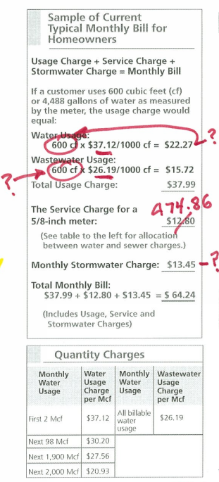
Project Summary
Analysis 1: Rainwater Collection
Analysis Goals
Data Collection
Description & Design
Cost Estimation
Economic Analysis
Analysis 2: Photovoltaic Array
Analysis Goals
Data Collection
Description & Design
Electrical Breadth
System Layout & Cost Estimation
Economic Analysis
Analysis 3: Operable Solar Shading
Analysis Goals
Colt Shadoglass
Cost Estimation
Sequencing, Schedule, Logistics
Energy Model
Mechanical Breadth
Thesis Recap
Acknowledgements
Bob Stano | Construction
Appendix – Rainwater Collection
Aria Health | Torresdale Campus | ED Expansion
Pump Sizing – Fixture Units
10 fixture units per water closet
5 fixture units per urinal
Hydro Pneumatic Tank Sizing
Worked backwards….
Rainwater Economic Analysis
Maintenance: 16 hours/day at union plumber wage of $59.68/hour
General Inflation = 3% per year
Utility Inflation = 5% per year
Assume 850 Gal, or 2/3 capacity is available before booster pump kicks on.
Cross referenced with the hunter curve to find 85 GPM
Pipe Wheel used for pipe sizing
for

Slide 21
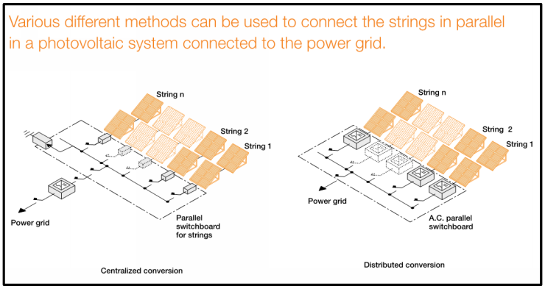
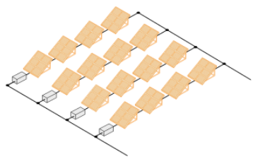
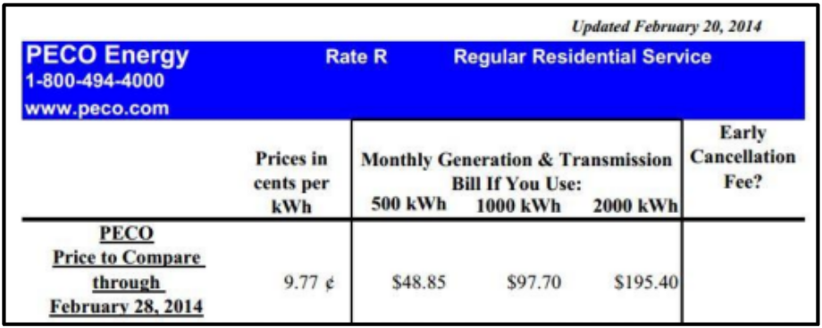
Project Summary
Analysis 1: Rainwater Collection
Analysis Goals
Data Collection
Description & Design
Cost Estimation
Economic Analysis
Analysis 2: Photovoltaic Array
Analysis Goals
Data Collection
Description & Design
Electrical Breadth
System Layout & Cost Estimation
Economic Analysis
Analysis 3: Operable Solar Shading
Analysis Goals
Colt Shadoglass
Cost Estimation
Sequencing, Schedule, Logistics
Energy Model
Mechanical Breadth
Thesis Recap
Acknowledgements
Bob Stano | Construction
Appendix – Photovoltaic Array
Aria Health | Torresdale Campus | ED Expansion
Photovoltaic Economic Analysis
Maintenance: 16 hours/day at union electrician wage of $110.64/hour
General Inflation = 3% per year
Utility Inflation = 5% per year
Solar Renewable Energy Credits
It is assumed that SREC’s will DEFLATE by 5% per year for ten years, after which SREC’s will no longer exist.
ABB: Protecting and Isolating PV Systems

Slide 22
Project Summary
Analysis 1: Rainwater Collection
Analysis Goals
Data Collection
Description & Design
Cost Estimation
Economic Analysis
Analysis 2: Photovoltaic Array
Analysis Goals
Data Collection
Description & Design
Electrical Breadth
System Layout & Cost Estimation
Economic Analysis
Analysis 3: Operable Solar Shading
Analysis Goals
Colt Shadoglass
Cost Estimation
Sequencing, Schedule, Logistics
Energy Model
Mechanical Breadth
Thesis Recap
Acknowledgements
Bob Stano | Construction
Appendix – Solar Shading
Aria Health | Torresdale Campus | ED Expansion
Industry Standard Value

